Slide 1
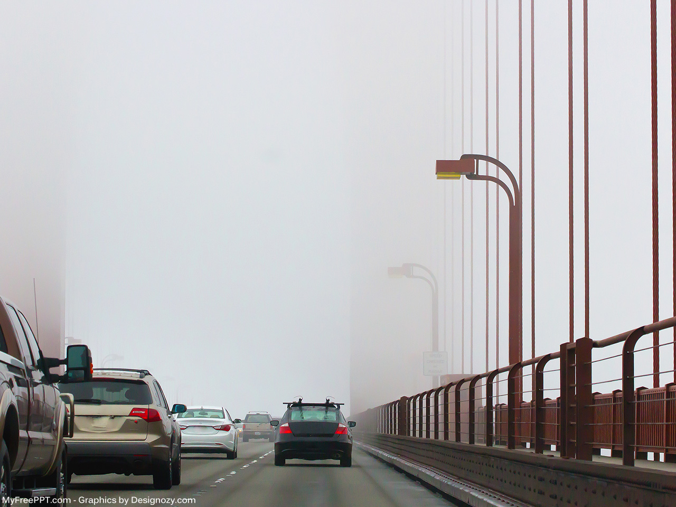
ELECTRONIC TOLL
COLLECTION
Supervisor:
Dr. Bright Yeboah-Akowuah
Project Members:
Abeka Ama Tabitha
Acquaye Christabel
1

Slide 2

PRESENTATION OUTLINE
PROJECT BACKGROUND
PROBLEM STATEMENT
PROJECT OBJECTIVES
PROJECT SIGNIFICANCE
LITERATURE REVIEW
METHODOLOGY AND PROJECT DESIGN
PROJECT TIMELINES
2

Slide 3
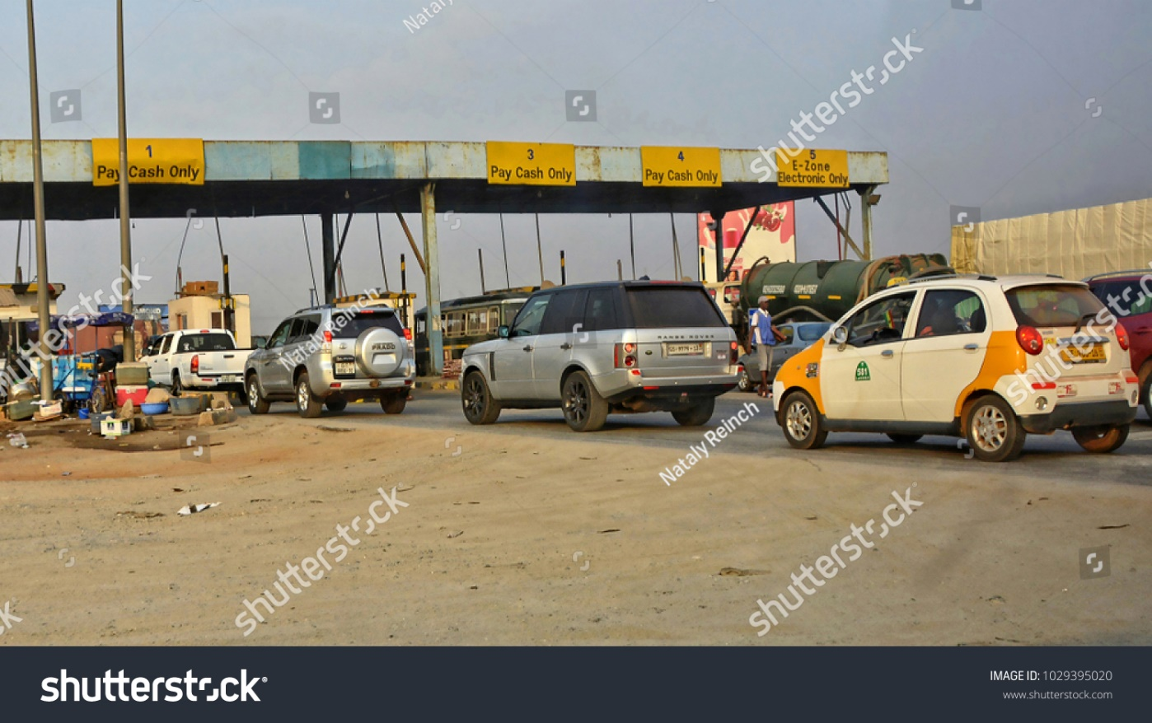

BACKGROUND
Purpose of toll collection
Toll collection system used in Ghana
3

Slide 4
PROBLEM STATEMENT
The non-existence of a credible toll collection system in Ghana.
4

Slide 5
OBJECTIVES
General
Ensure accountability on toll roads.
Specific
Create a central database and web server to store and retrieve information about registered vehicles.
Create a web platform for administrators to manage the entire Electronic Toll Collection System.
Create a mobile client for vehicle owners to facilitate transactions and manage account information.
5

Slide 6
SIGNIFICANCE
Reduction in traffic congestion
Reduction in fuel consumption
Reduction in carbon dioxide emissions
Saving time in travel
6

Slide 7
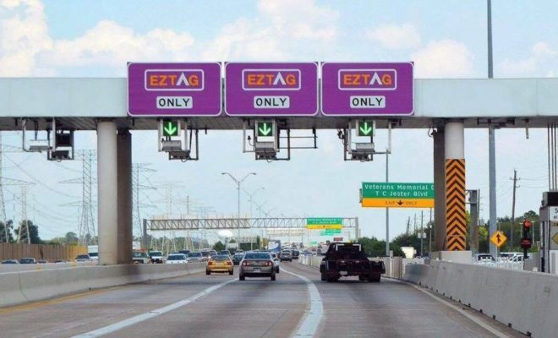
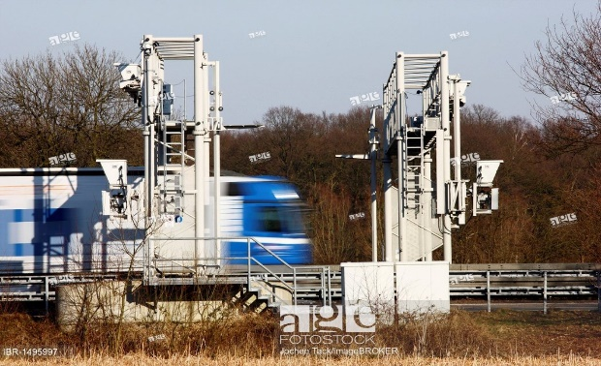
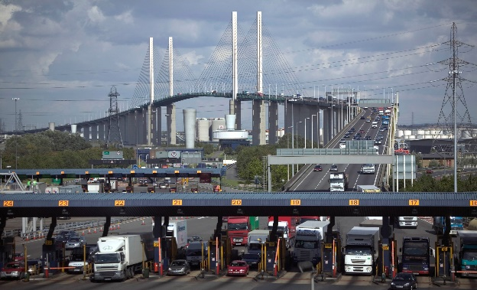
LITERATURE REVIEW
Harris County Toll Road Authority (EZ Tag) in Houston, USA.
RFID technology used.
Autobahn toll collect for trucks in Germany
Odometer and GPS used.
Dart Charge by UK Government since November 2014
ANPR System Used.
7

Slide 8
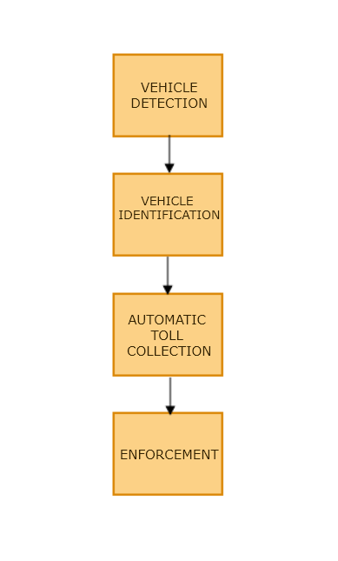
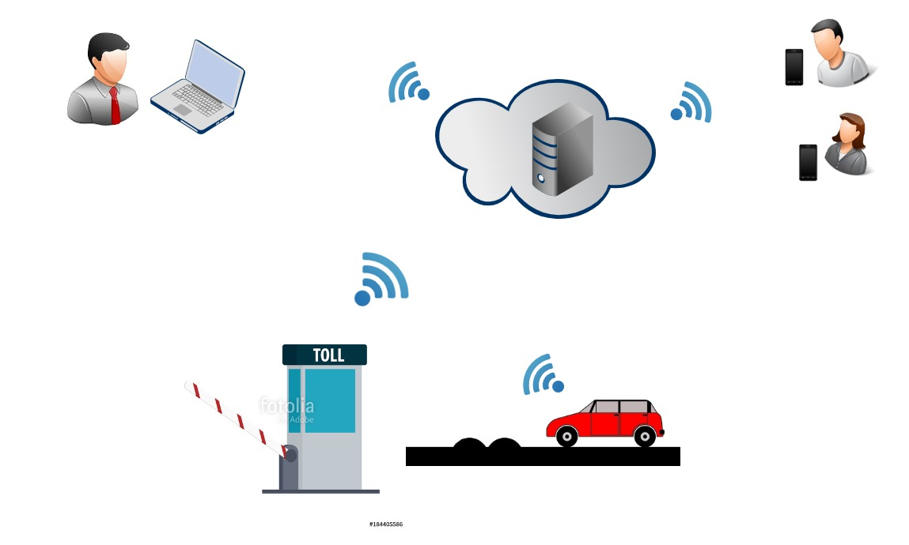
SYSTEM ARCHITECTURE
8

Slide 9
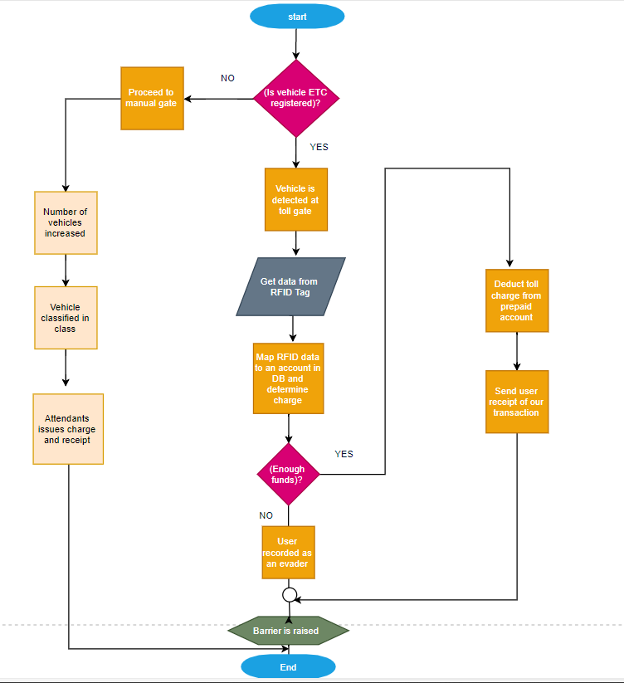
SYSTEM FLOWCHART
9

Slide 10
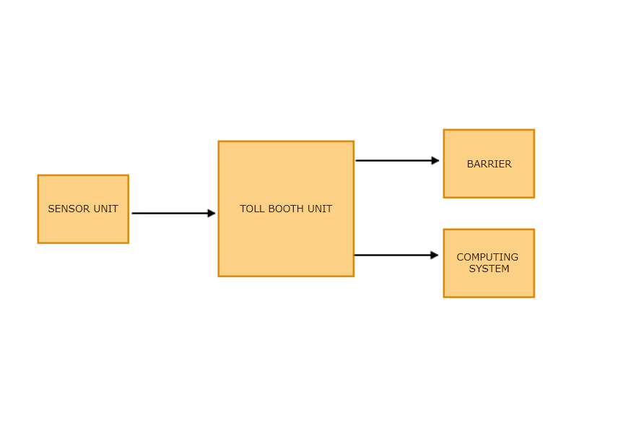
SYSTEM BLOCK DIAGRAM
10

Slide 11
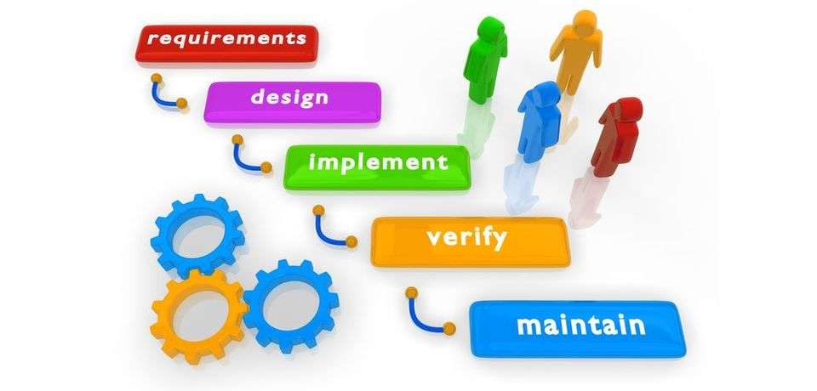
SOFTWARE ENGINEERING MODEL
11

Slide 12
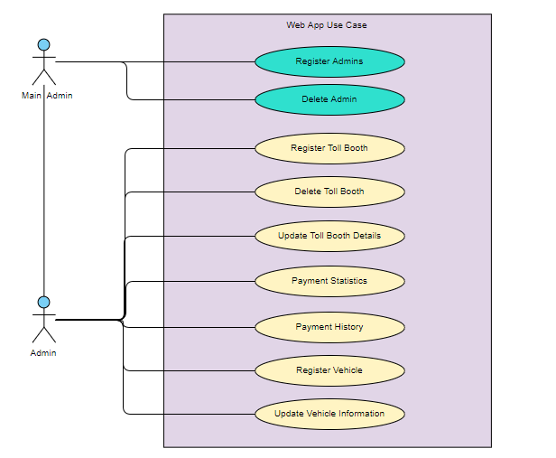
USE CASE: ADMINISTRATOR
12

Slide 13
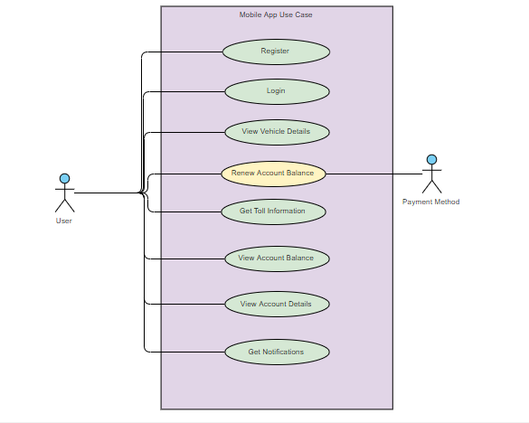
USE CASE: USER
13

Slide 14
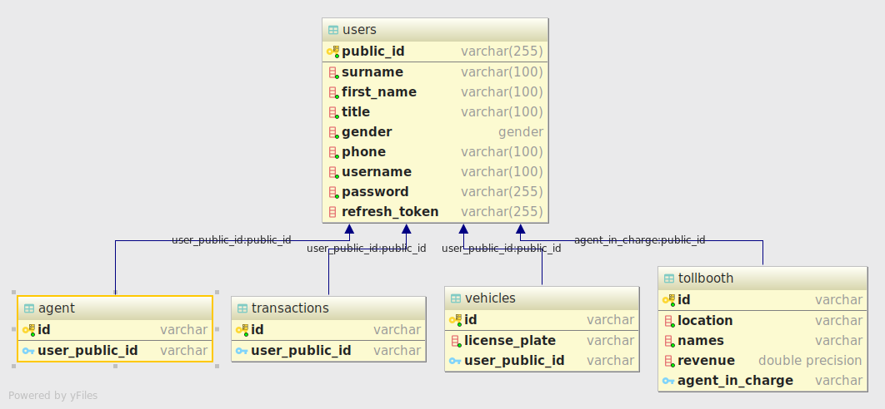
ER DIAGRAM
14

Slide 15
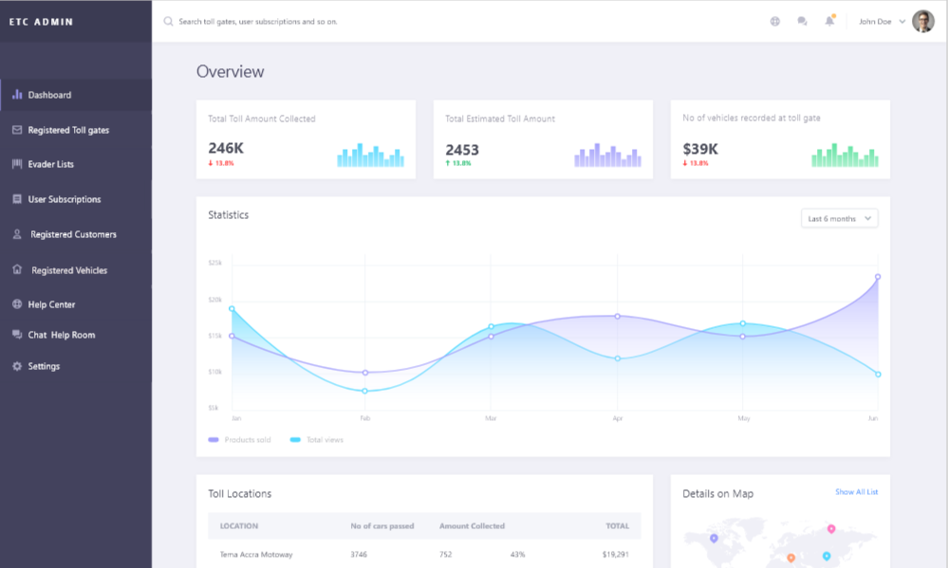
PROTOTYPE FOR ADMINS
15

Slide 16

PROTOTYPE FOR DRIVERS
16

Slide 17
PROJECT TIMELINES
17

Slide 18
THANK YOU
18

